Slide 1

Assessing mortality as an outcome in the MIMIC-III Database
BMIN503 – Final Project Presentation – December 5th, 2019
Presented by Silvia P. Canelón, PhD
Postdoctoral Researcher Penn Dept. of Biostatistics, Epidemiology & Informatics

Slide 2
Background
Secondary analysis of Electronic Health Records (EHR) can provide additional information about patients that are often under-represented in clinical studies, such as pregnant patients
The U.S. has the worst rate of maternal deaths among developed nations, highlighting a critical area requiring additional research
Pregnant patients could die or suffer other adverse outcomes during their care

Slide 3
Objectives
Utilize a database containing medical records from intensive care units of a large medical center
Describe characteristics of the patient population
Study mortality as an outcome with a variety of patient care predictors
Assess suitability of the MIMIC-III database to study pregnancy-related outcomes (i.e. cesarean section), particularly as relating to mortality

Slide 4
Data Source: MIMIC-III Critical Care Database
Medical Information Mart for Intensive Care III
Freely-available database with de-identified health-related data
Beth Israel Deaconess Medical Center in Boston, Massachusetts
40,000+ patients admitted to intensive care 2001-2012
Includes demographics, vital sign measurements, laboratory test results, procedures, medications, caregiver notes, imaging reports, and mortality (both in and out of hospital) across 26 tables

Slide 5
Approach
Tidy the data!
Formatting/recoding variables
Joining data from multiple tables: admission records + patient information + diagnosis/procedure records + ICD code definitions
Identifying delivery and c-section records using ICD9 billing codes
Describing the patient population
Using logistic regression to study mortality as an outcome

Slide 6
Results: General record information
Admission records: 58976
Adult records: 54362
Patients: 46520
Adult patients: 38552
Diagnosis records: 651047
Procedure records: 240095

Slide 7
Results: Patient demographics – Age
Average age at time of admission: 64.02 ± 16.99 years
Average age at time of death: 70.13 ± 14.87 years

Slide 8

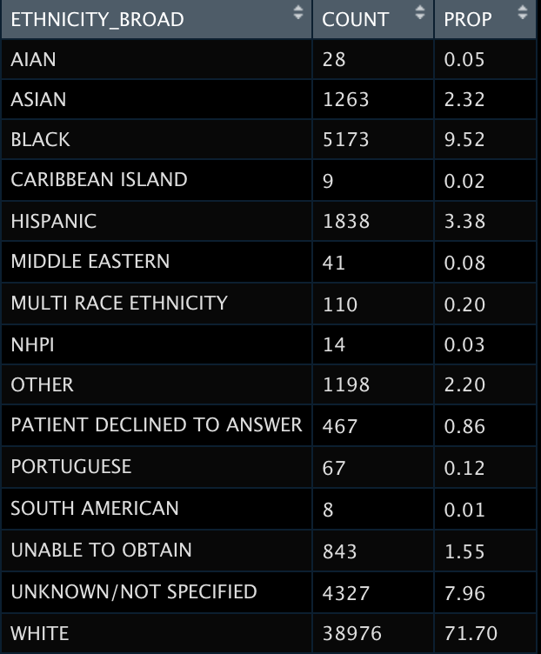

Results: Demographics – Sex/Gender, ethnicity, and insurance type
GENDER
ETHNICITY
INSURANCE

Slide 9




Results: Outcomes – Delivery, c-section, mortality
DELIVERY
C-SECTION
MORTALITY
ADMISSION_TYPE

Slide 10
Results: Outcomes – Delivery, c-section, mortality
DELIVERY
C-SECTION
MORTALITY
ADMISSION_TYPE

Slide 11
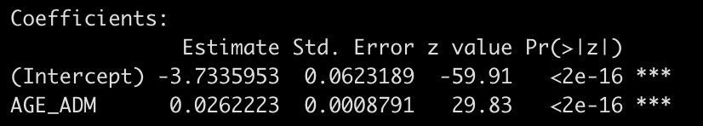
AGE_ADM was positively associated with MORTALITY with p-value <2e-16

Slide 12
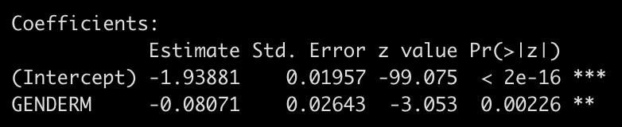
GENDER MALE was negatively associated with MORTALITY with p-value 0.00226

Slide 13
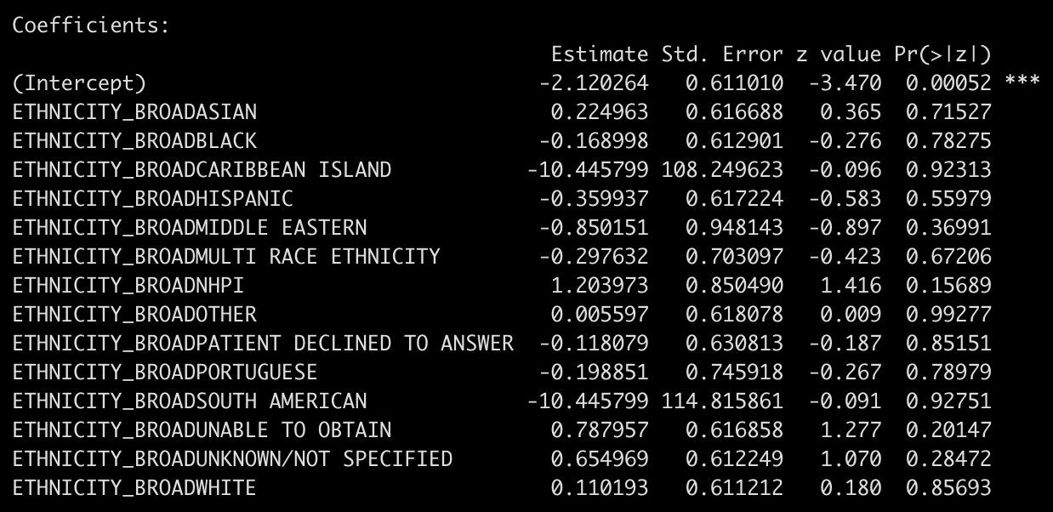
No signficant association between any particular ETHNICITY and MORTALITY

Slide 14
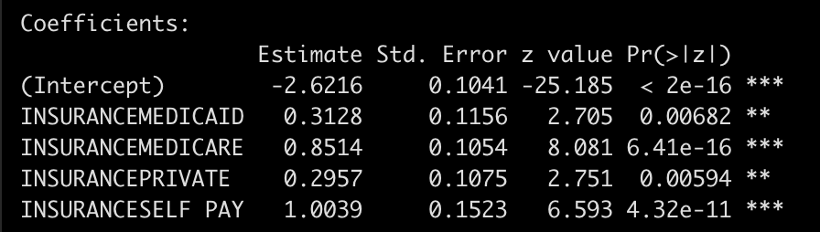
Significant association between all INSURANCE types and MORTALITY (i.e. having any insurance)

Slide 15
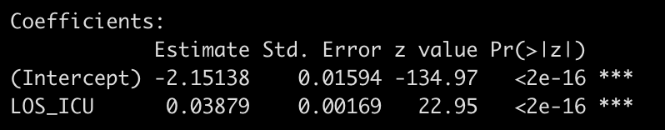
LOS_ICU was positively associated with MORTALITY with p-value <2e-16

Slide 16
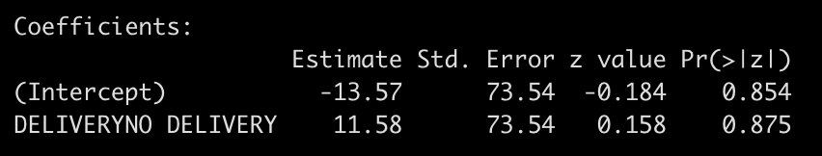
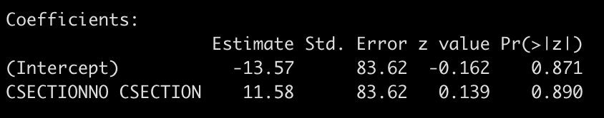
MORTALITY outcome with DELIVERY and CSECTION as predictors
Non-significant positive association between NO DELIVERY and MORTALITY
Non-significant positive association between NO CSECTION and MORTALITY

Slide 17
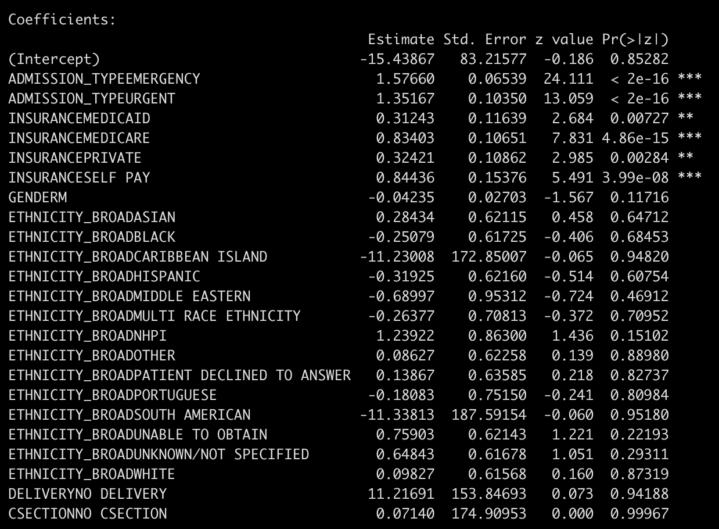
Logistic regression including all categorical variables
EMERGENCY and URGENT admissions were significantly associated with MORTALITY
All INSURANCE types significantly associated with MORTALITY

Slide 18
Limitations
Dates in the database have been shifted to protect patient confidentiality
Date shifting removed:
Year - The year is randomly distributed between 2100 – 2200
Day of the month - The absolute day of the month is not preserved
Inter-patient information - Two patients in the ICU on 2150-01-01 were not in the ICU at the same time
Not all `ICD9_CODES` in the database match to a ICD code
Population is mostly older which means fewer pregnancies, so pregnancy-related outcomes are not easily studied

Slide 19
Acknowlegements
Mary Regina Boland; Assistant Professor of Informatics; Department of Biostatistics, Epidemiology, and Informatics
Ray Bai; Postdoctoral Researcher; Department of Biostatistics, Epidemiology, and Informatics
Lena Davidson; Data Analyst; Department of Biostatistics, Epidemiology, and Informatics

